Slide 1

Historical Weather Data Dashboard
Madhulika Sawant

Slide 2
Parameters
Airport locations selected instead of city center
SFO San Francisco, CA
LAS Las Vegas, NV
LAX Los Angeles, CA
Ingested daily historical weather data
Jan 2023 - Dec 2025

Slide 3
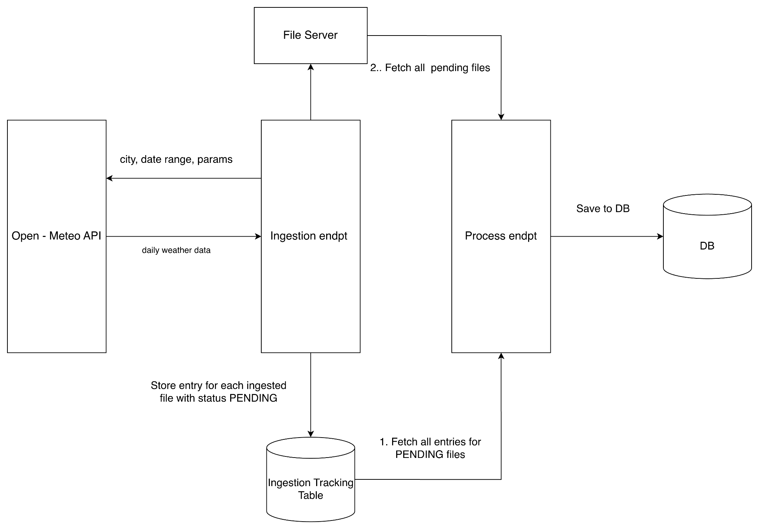
Backend Flow

Slide 4
Ingestion
Manual ingestion for predefined set for locations (stored in locations table) and given date range.
Writes received response per location to file of format {city}-{start_date}-{end_date}.json
Stores all files in data/ folder
A entry is inserted in ingested_files table with status PENDING.
Decouples ingestion from processing of files, making it easier to reprocess files if data gets corrupted or processing pipeline breaks.

Slide 5
Processing
Fetches all PENDING files and processes upto 5 files simultaneously
Flattens response nested fields, by exploding data using df.explode()
Standardizes data types for attributes
Renamed columns to include unit of measurement
Valid value range checks for metrics (clipped values using df.clip())
-273.15 °C <= Temperature <= 1.42e32
Wind speed >= 0
Precipitation >= 0
0 <= Precipitation hours <= 24
0 <= Avg cloud cover % <= 100
Created new columns like epoch_timestamp, day_of_month, month_int, etc…

Slide 6
Processing
No missing values in the data but includes imputation step for potential missing values:
Random missing values
For continuous observed metrics like temperature, wind speed, imputation done by interpolation
For episodic metrics like precipitation, imputed with 0
Consecutive missing values
For continuous observed metrics like temperature, wind speed, imputation value is average over a 14 day window near missing values
For episodic metrics like precipitation, hybrid fill (forward fill 7 days and backward fill 7 days to create variance)
Deduplication of data handled by ignoring entries, present in the database
On successful processing, updates status of entry in ingested_files table to COMPLETED
On failure, updates status of entry in ingested_files table to FAILED

Slide 7
Database Setup
Containerized postgres db
Setup migration using alembic
Used sqlalchemy ORM in the backend to execute database operations

Slide 8
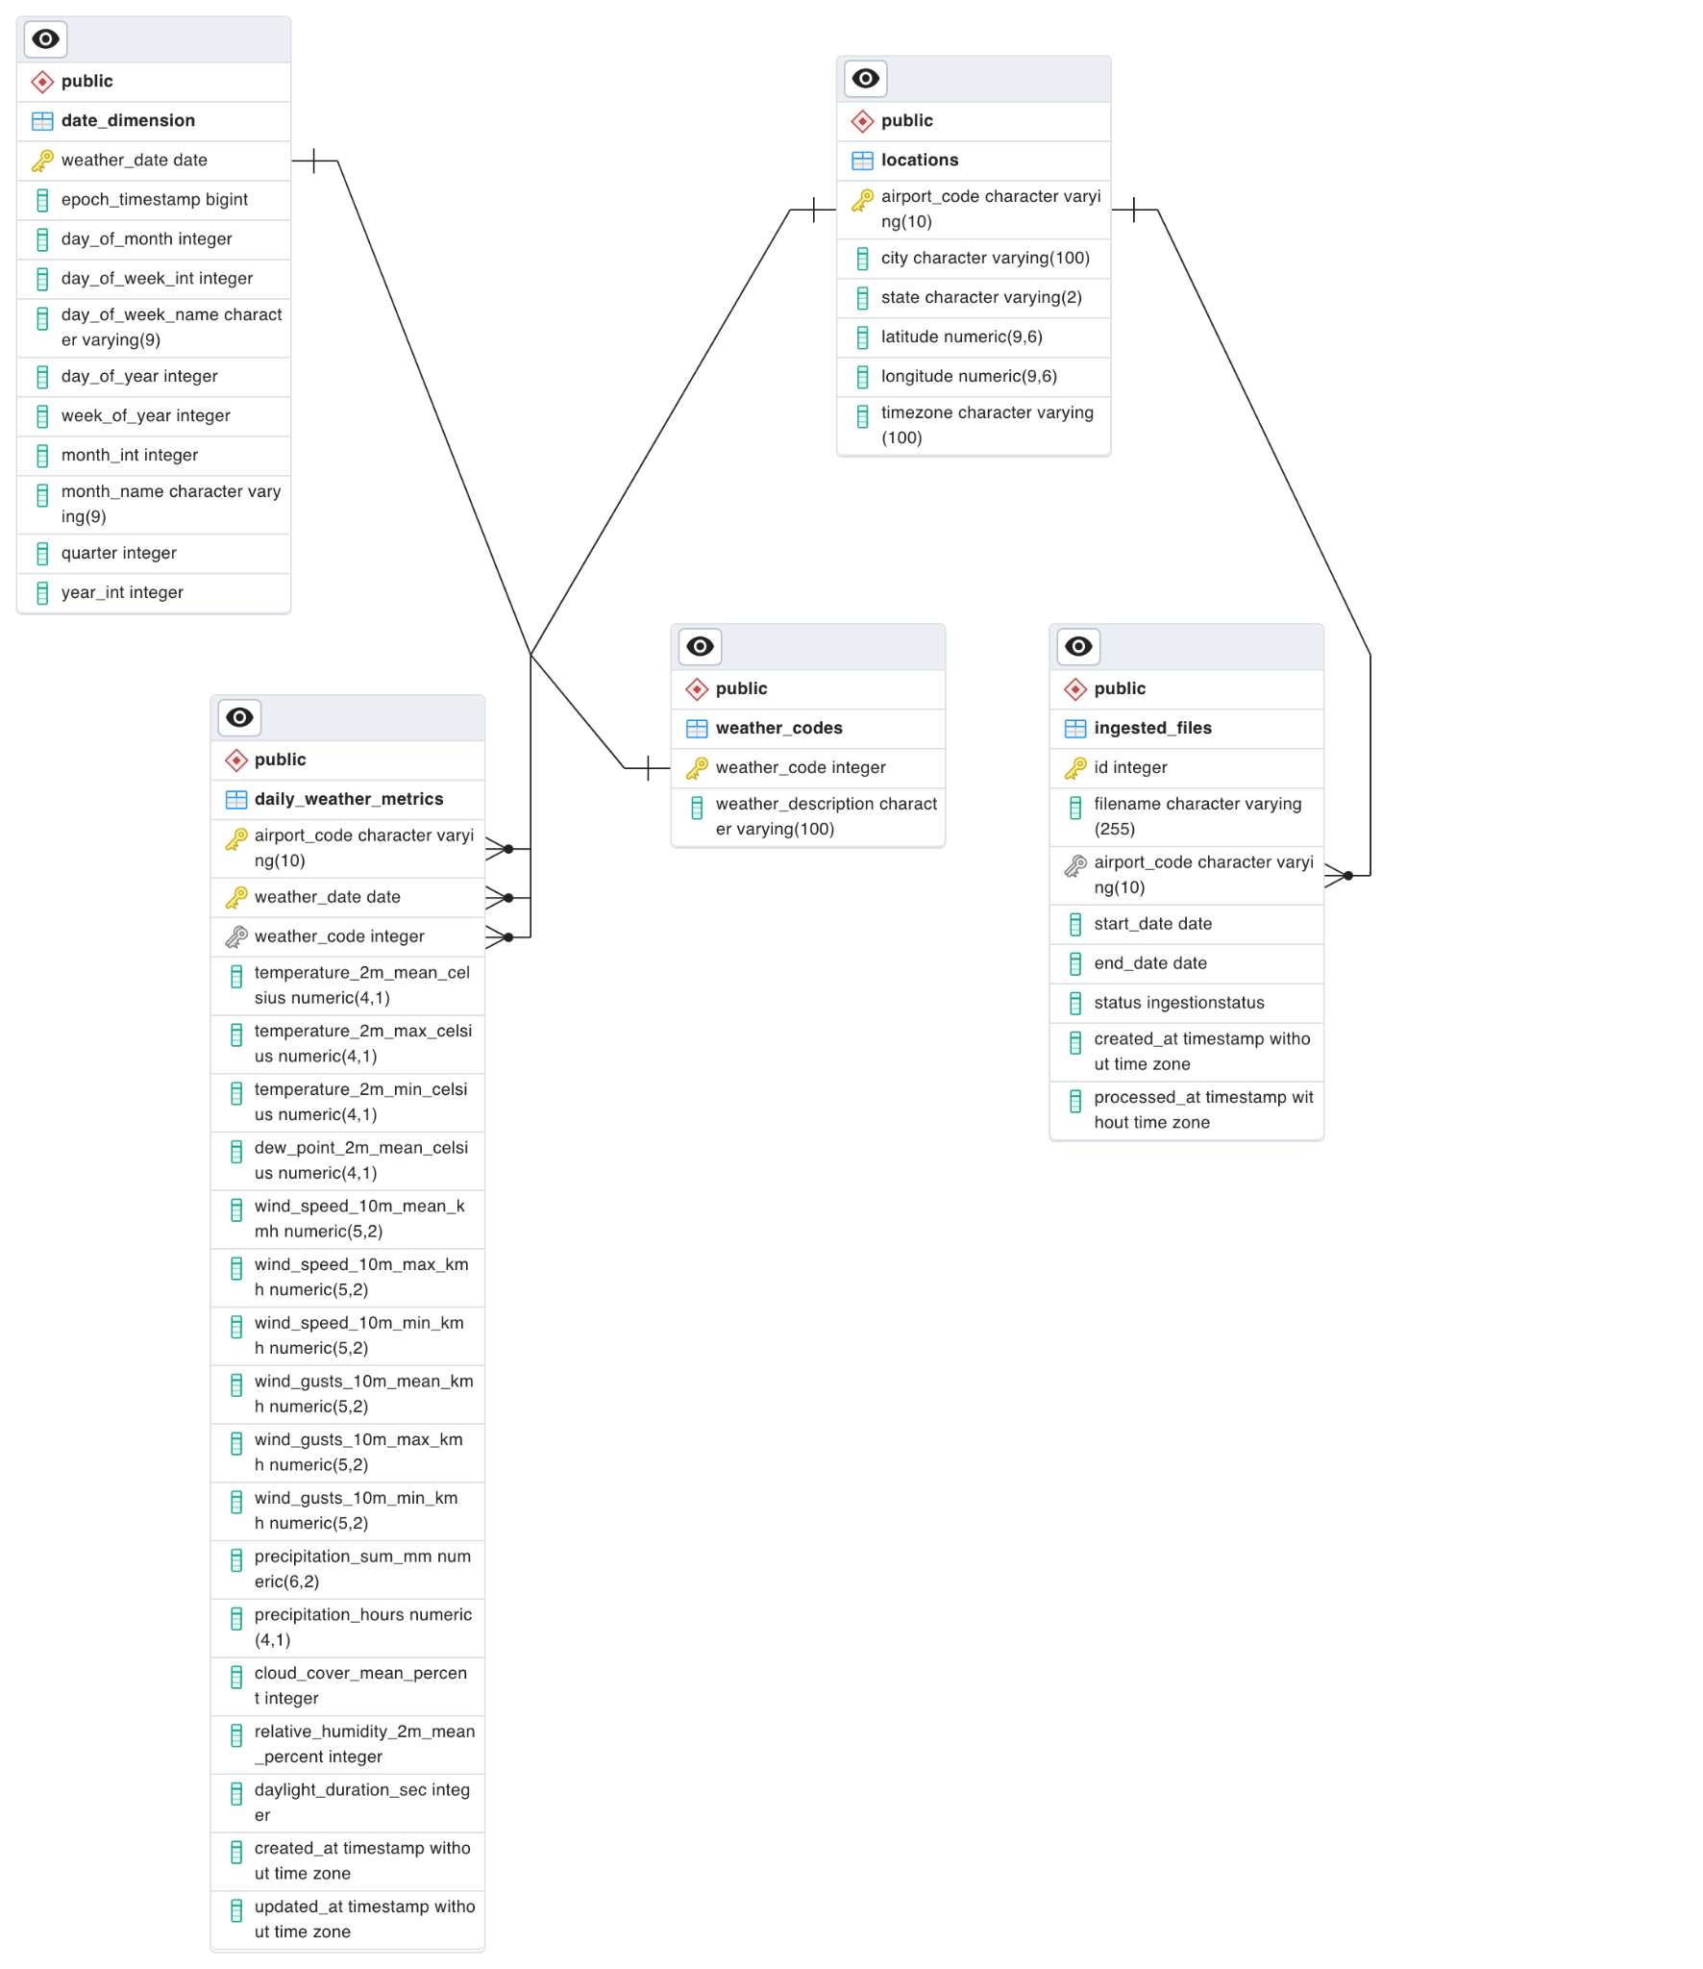
ERD

Slide 9
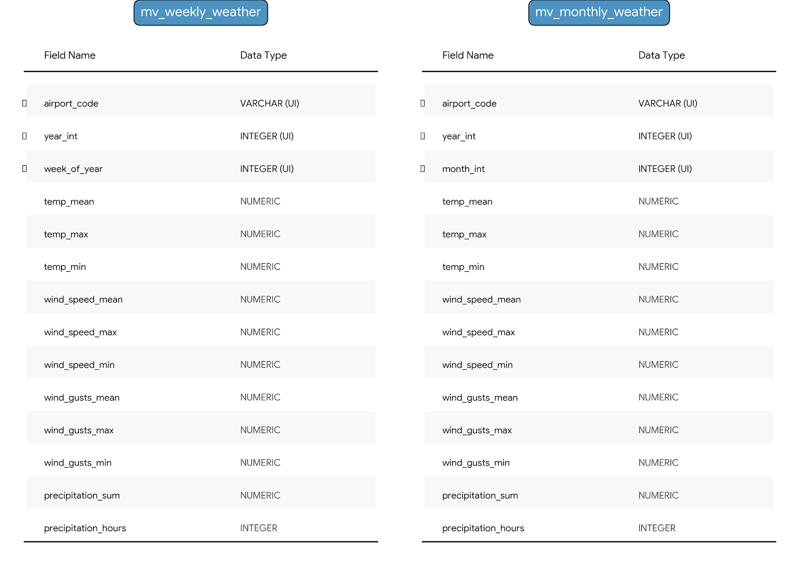
Materialized Views

Slide 10
Demo Time

Slide 11
Thank
you

